Slide 1
A Self-Renewing, Resilient and
Sustainable Society
Contribution by the officials of the
Ministry of Finance
4.2.2019

Slide 2
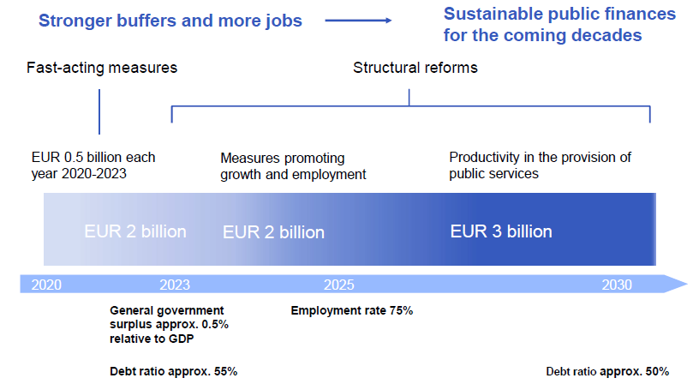

Slide 51
Mr Sami Yläoutinen
Economic Policy Coordinator
Tel. +358 2955 30320
www.vm.fi
Media and Communications Unit
vm-viestinta@vm.fi
Media Service (during office hours; 8am - 4pm EET): Tel. +358 2955 30500

