Slide 1
Economic Survey
Spring 2016
14.4.2016,
Economics Department

Slide 2
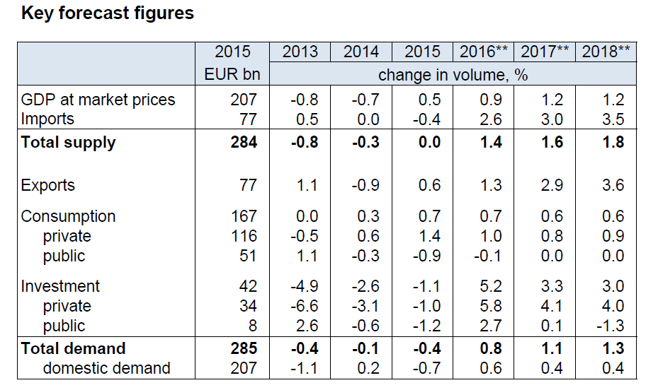

Slide 3
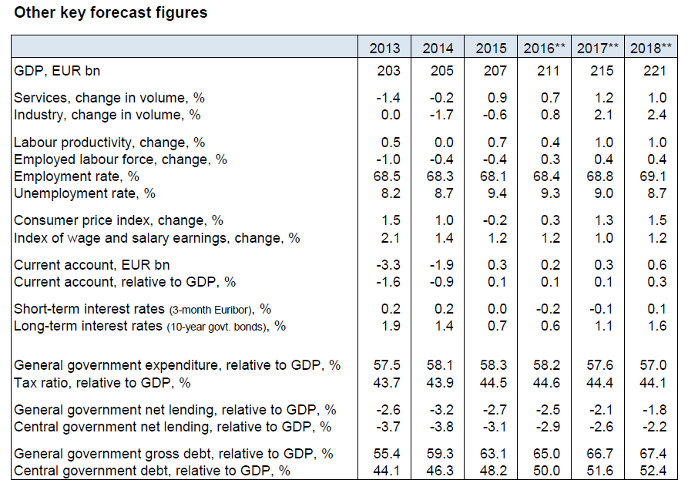

Slide 43
Mika Kuismanen
Head of Forecasting Unit
Economics Department
Tel. +358 2955 30021
www.vm.fi

