Slide 1
Outlook and challenges for Finland’s public finances
20.2.2017
Economics Department

Slide 14
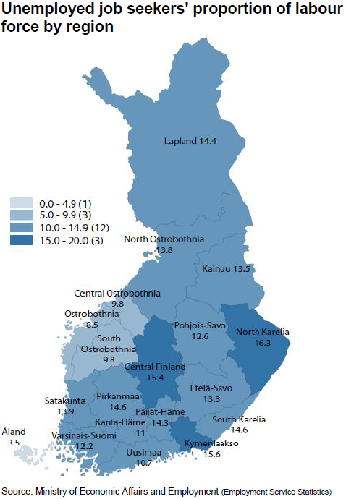

Slide 22
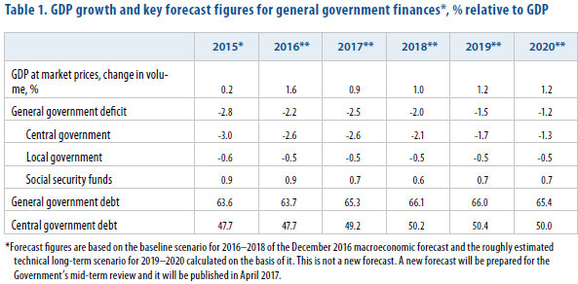

Slide 23
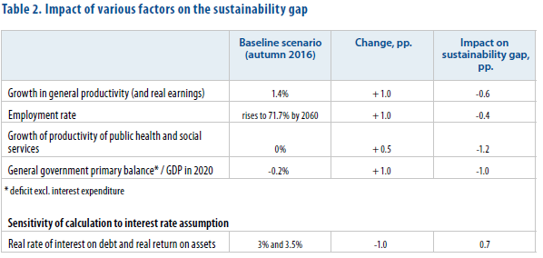

Slide 24
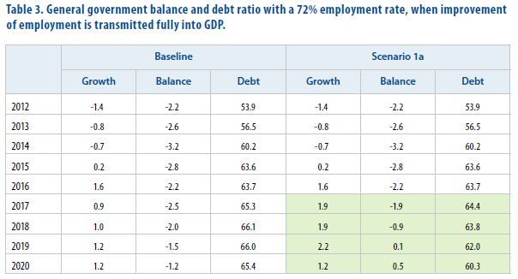

Slide 25
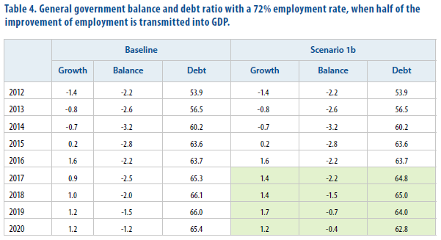

Slide 26
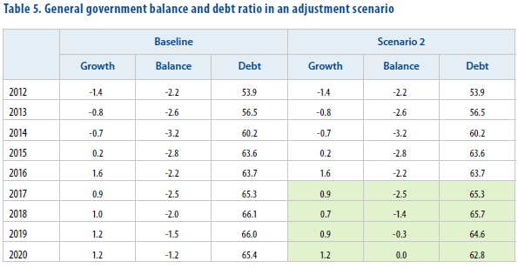

Slide 27
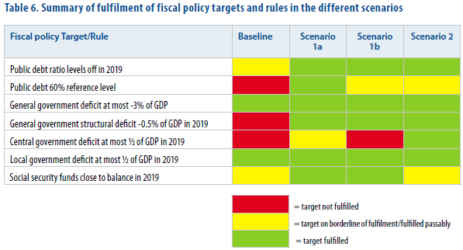

Slide 28
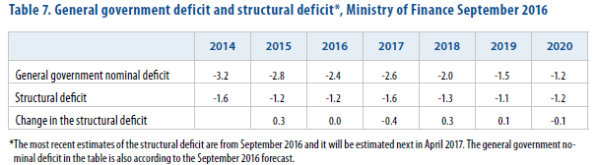

Slide 29
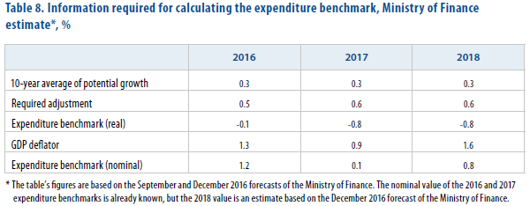

Slide 30
Mr. Mikko Spolander
Director General
Head of Department
tel. +358 2955 30006
www.vm.fi

