Slide 1
Economic Survey
Summer 2017
21.6.2017
Economics Department

Slide 8
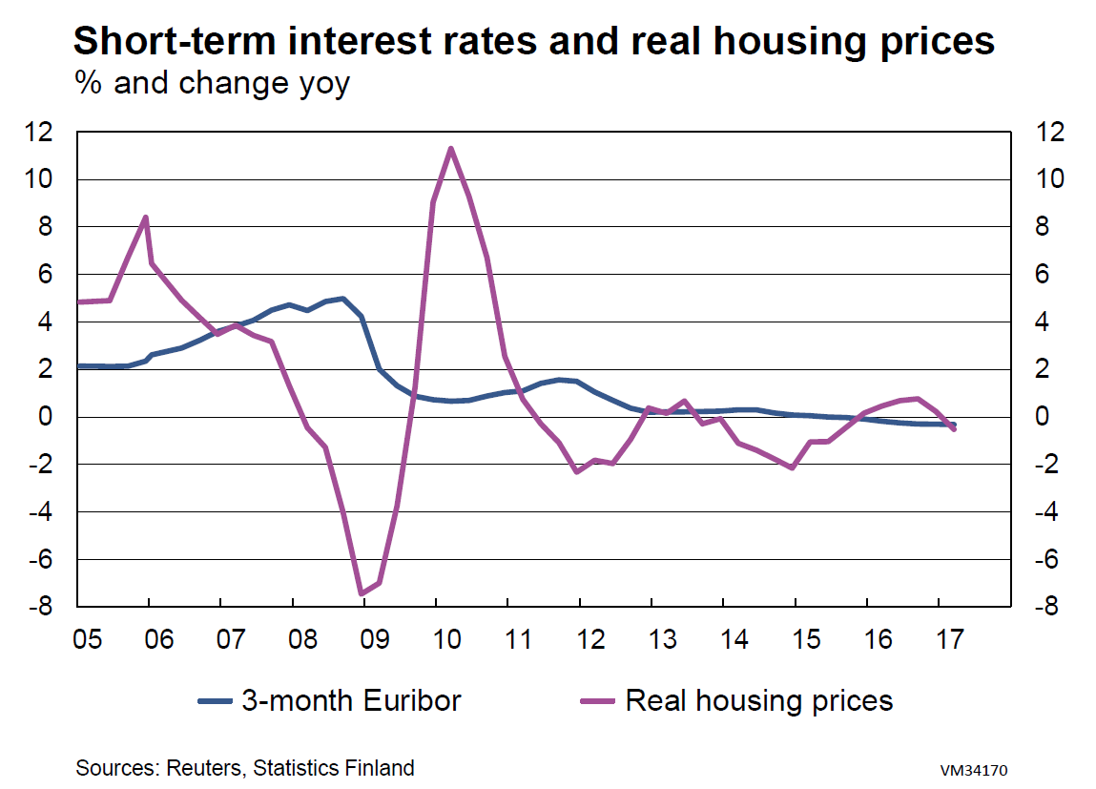

Slide 10
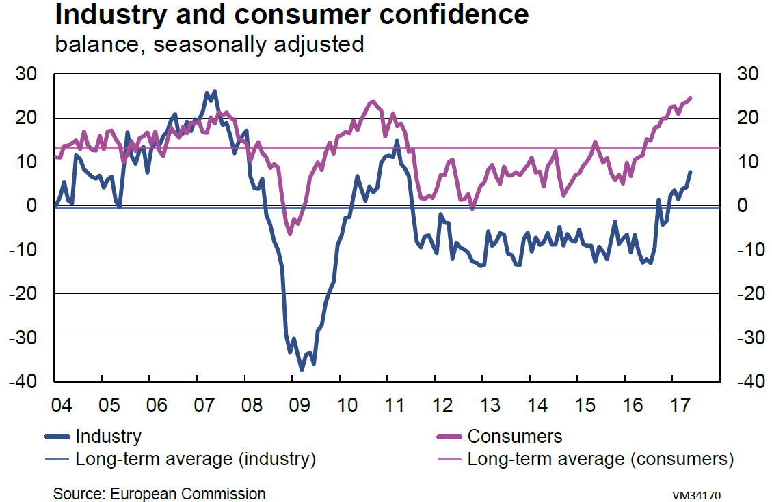

Slide 19
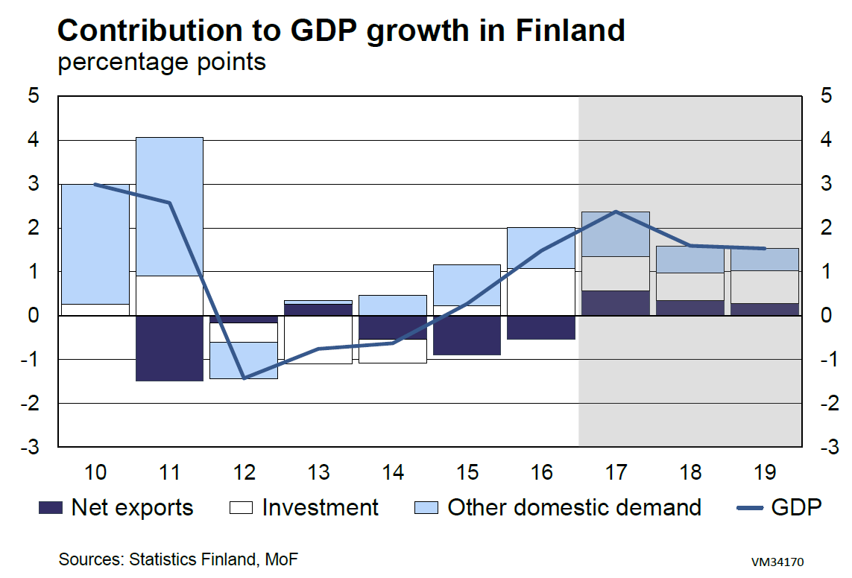

Slide 25
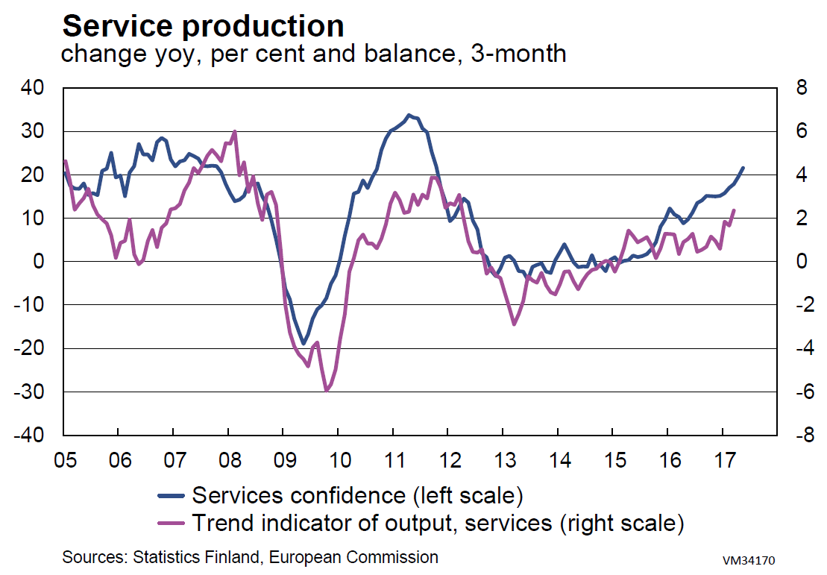

Slide 35
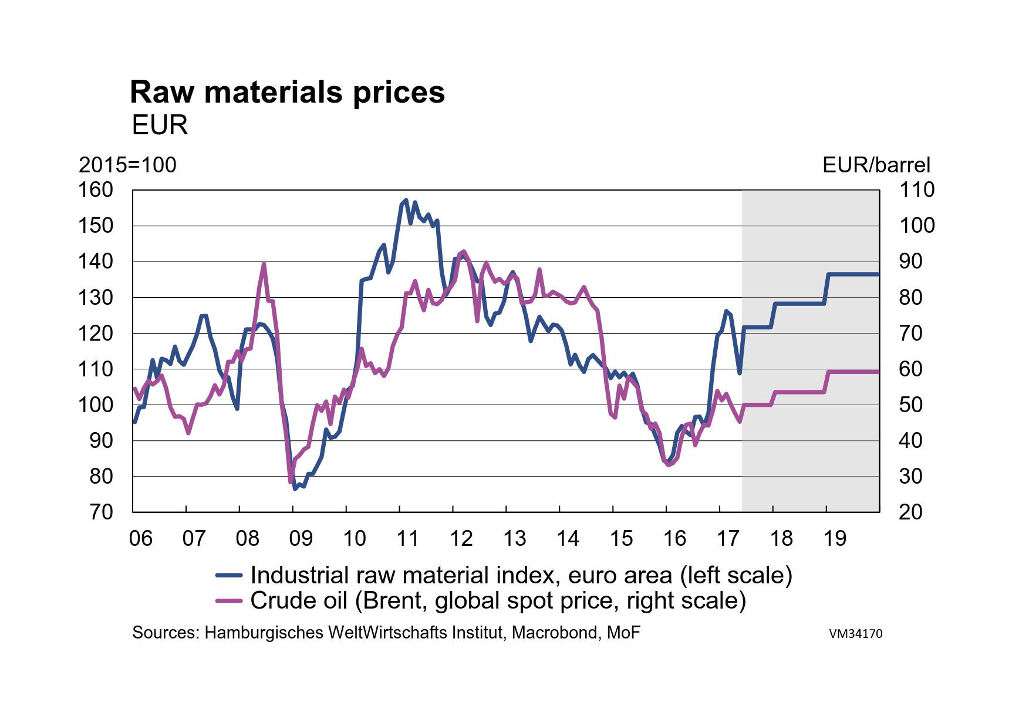

Slide 36
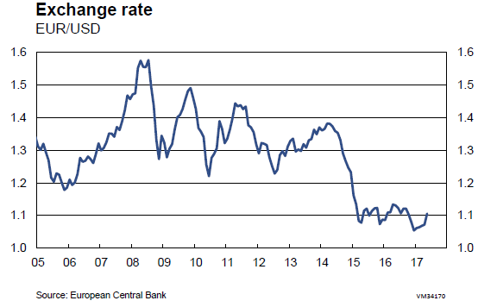

Slide 47
Mikko Spolander
Director general,
Tel. +358 2955 30006
www.vm.fi

