Slide 1
Economic Survey
Autumn 2017
19.9.2017
Economics Department

Slide 36
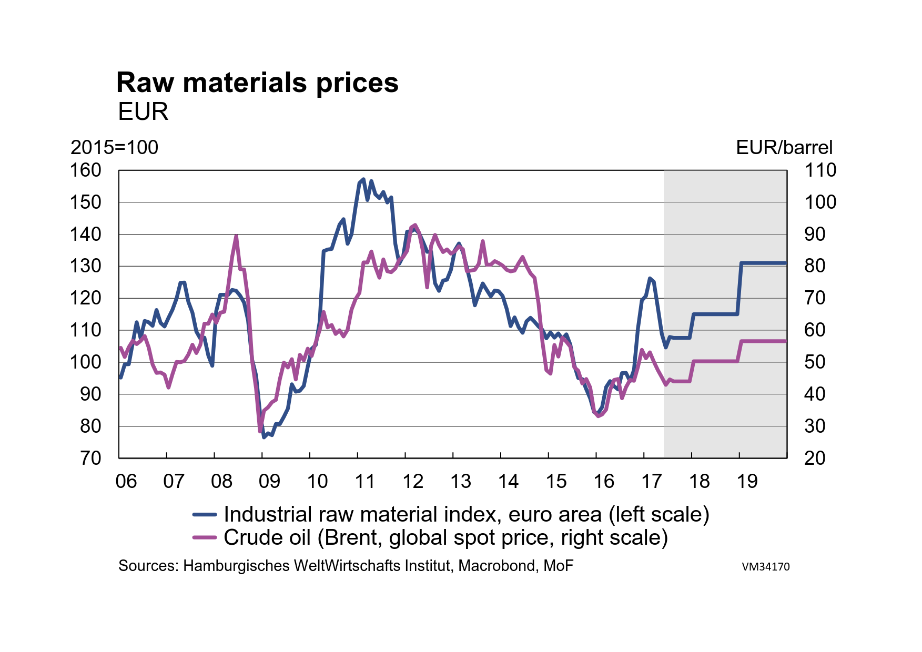

Slide 37
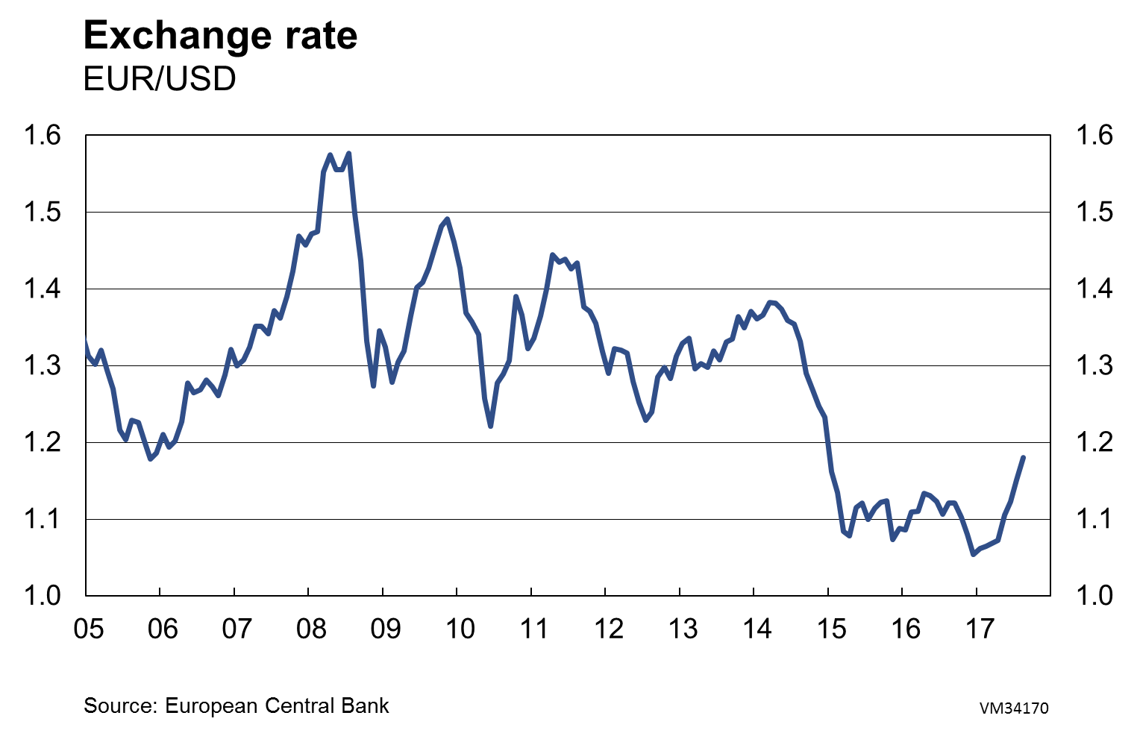

Slide 50
Mikko Spolander
Director general,
Tel. +358 2955 30006
www.vm.fi

